Slide 1



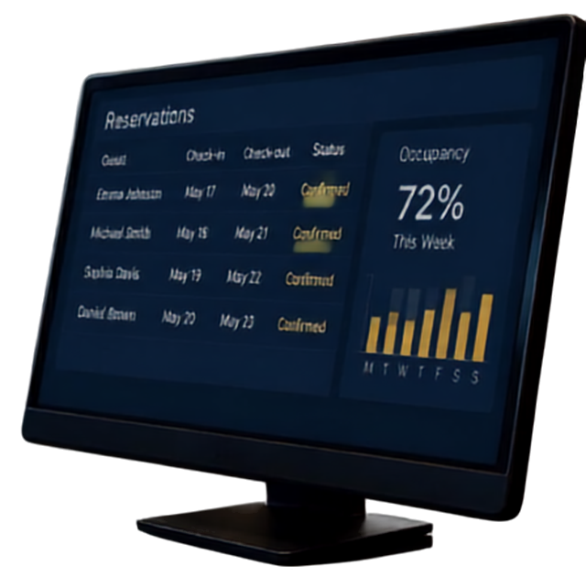


HOTEL BOOKING ANALYTICS
From Raw Data to
Customer Insights
An end-to-end project covering data cleaning, feature engineering, RFM customer segmentation, and an interactive Power BI dashboard.
Python (Pandas)
Power BI

Slide 2




Team Members
Nourhan Taha Mohamed Mostafa
Doaa Gamal Mohamed
Malak Mohamed Saeed
Zeina Mohammed Ozoris
Beshoy Hanna Zakaria
Sohaib Wael Barakat
PREMIUM

Slide 3













Project Overview
600,000
30
22
8
BOOKINGS ANALYZED
CITIES
COUNTRIES
CHANNELS
We analyze a large hotel booking dataset to uncover booking patterns, validate data quality, and segment customers by value.
ANALYTICAL WORKFLOW
01
02
03
04
05
The workflow moves from raw transactional data all the way to a decision-ready Power BI dashboard.
Feature Engineering
EDA
Cleaning
Preprocessing
RFM
Explore structure & quality
Duplicates,
nulls,
outliers
Consistency validation
New analytical columns
Customer segmentation
Data Modeling & Summarization
06

Slide 4

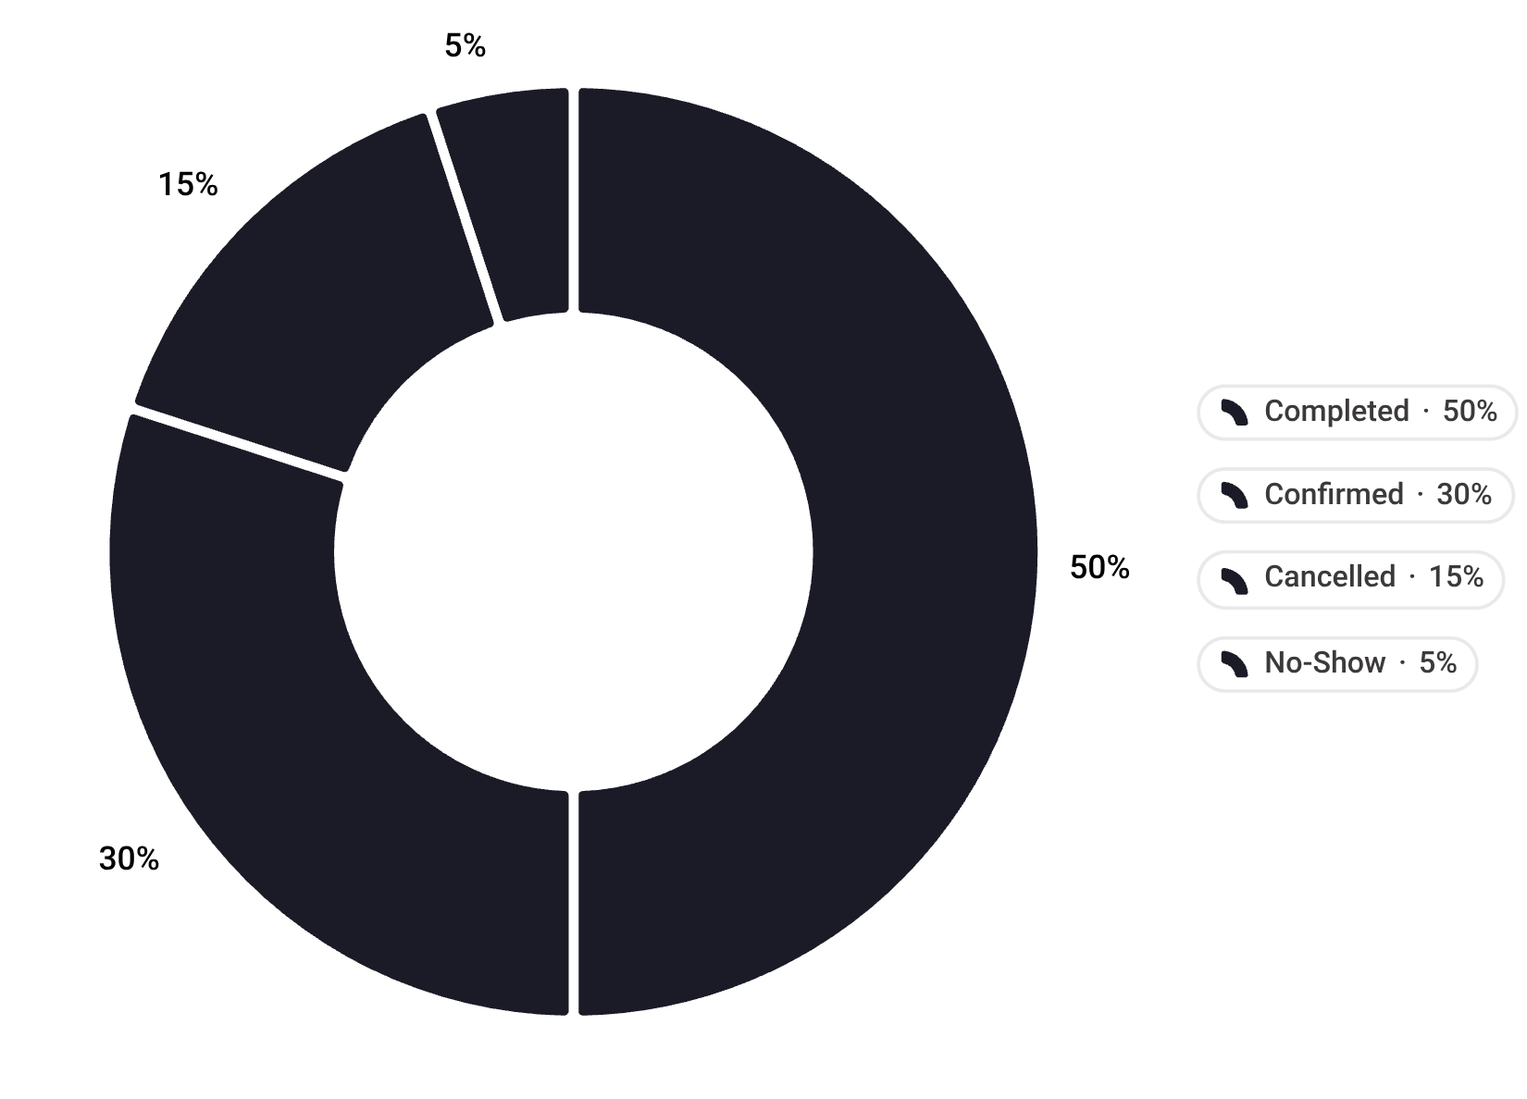



Dataset Overview
AVERAGE NIGHTS
PER BOOKING
AVERAGE TOTAL PRICE
PER BOOKING
MOST COMMON
ROOM TYPE
TOP BOOKING
CHANNEL
7.50
$1,854
Triple
Booking.com
BOOKING STATUS BREAKDOWN
50.0%
30.0%
15.0%
5.0%
Completed
Confirmed
Cancelled
No-Show

Slide 5








Data Cleaning & Validation
Duplicate rows
dataset clean of exact duplicates
Missing values
no nulls in 22 columns
Outliers (IQR method)
adults, children, nights, and price all within range
Logical inconsistencies
validated nights vs. dates, prices, guests
Total price vs.
(price per night × nights)
0.95
Outlier handling
IQR-based clip() applied with no actual data change due to zero outliers.
ratio averages
range 0.66–1.53

Slide 6















Feature Engineering
New analytical columns for deeper insights
4
1
TIME FEATURES
capture check-in year, month, weekday, and weekend flag
2
LENGTH OF STAY
calculate stay duration from check-out minus check-in dates
3
DOMESTIC VS. INTERNATIONAL
NEW DIMENSIONS
identify domestic bookings in Egypt with a clear booking flag
richer signals, better decisions
4
POPULARITY COUNTERS
aggregate hotel and city booking volumes for demand signals

Slide 7








RFM Customer Segmentation
Score customers across three dimensions to reveal value-driven segments.
R
RECENCY
F
FREQUENCY
M
MONETARY
Days since last booking
Number of unique bookings
Total amount spent
(mostly 1 due to unique guest_email per booking)
Each dimension scored 1–5 (quintiles)
RFM SCORE
combined and mapped to customer segments
BRONZE
SILVER
GOLD
PREMIUM
PLATINUM
Important note:
Frequency dimension is limited by the dataset's unique guest_email per booking.

Slide 8
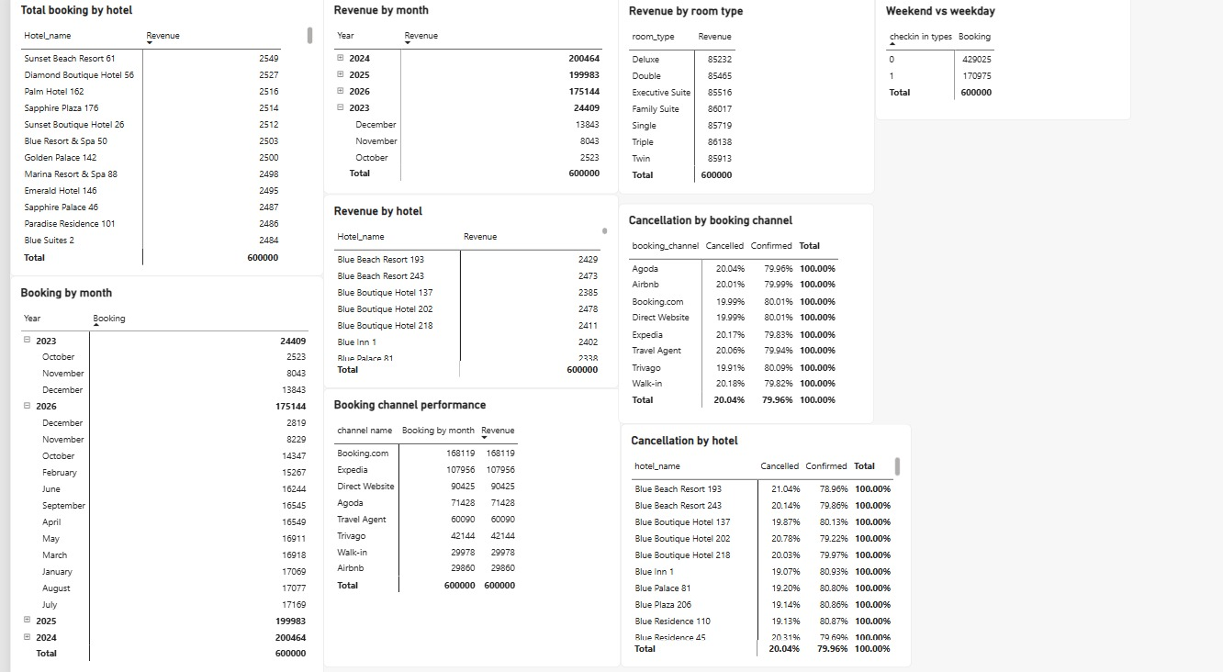
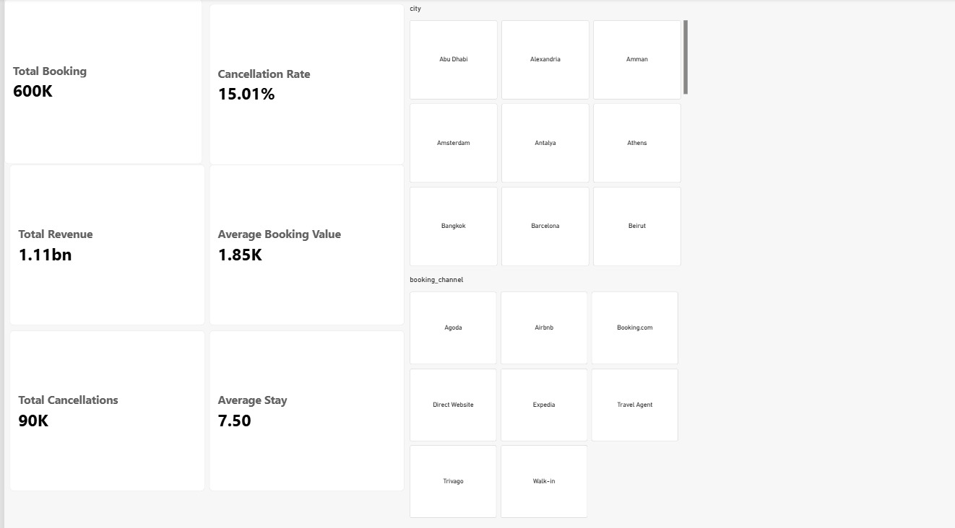
Data Modeling & Summarization
Matrix Power Bi and KPIs reveal key business patterns
1
WEEKEND: 71.5%
$1.11B
Weekend bookings far outweigh weekday demand across the dataset
TOTAL REVENUE
2
TOP CHANNEL
from 600,000 analyzed bookings
Booking.com leads with 168,000+ bookings, ahead of Expedia and Direct Website
3
AVERAGE BOOKING VALUE
Around $1.85K per booking, with an average stay of 7.5 days
4
CANCELLATIONS
PREMIUM
Similar cancellation rates across channels; room-type demand is balanced

Slide 9

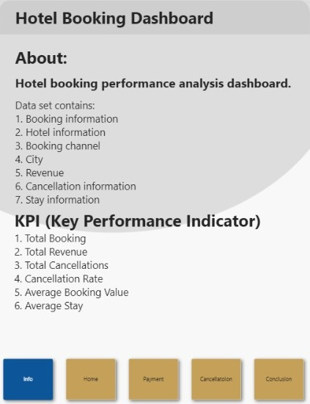
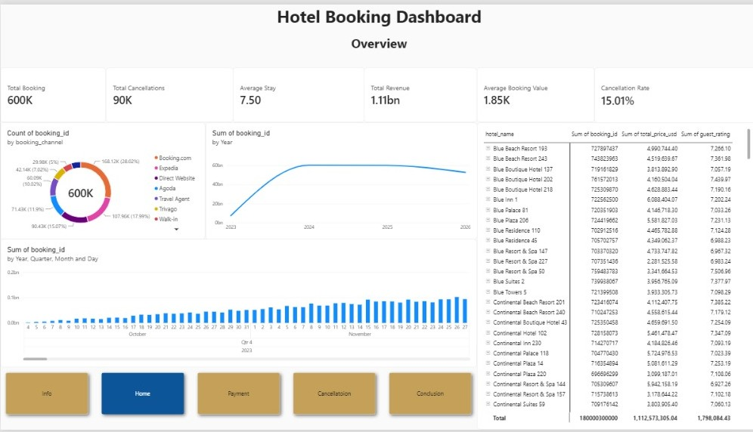

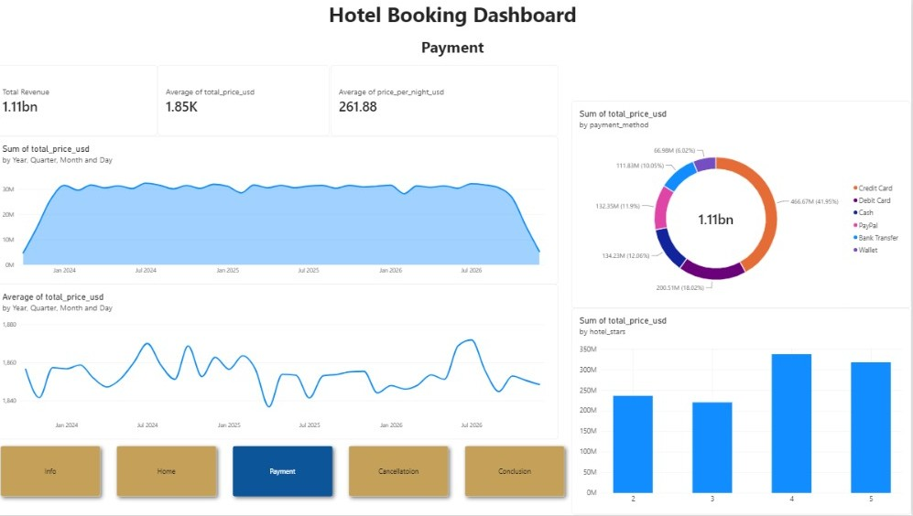

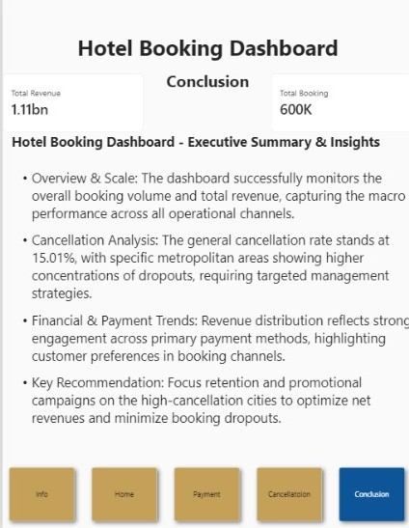





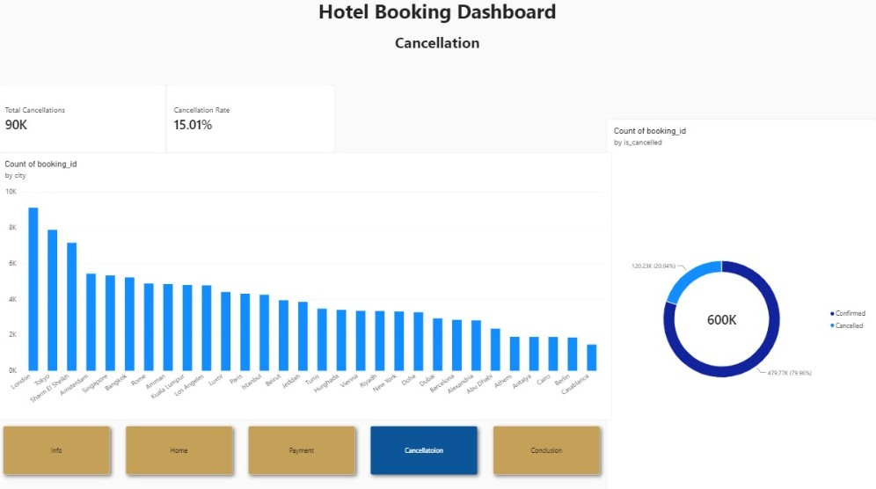
Dashboard & Conclusion
An interactive Power BI dashboard turns 600,000 raw bookings into real-time insights that drive smarter decisions.
DASHBOARD PAGES
KPIs
Info
Home
Payment
Cancellation
Conclusion
TOTAL BOOKING
TOTAL REVENUE
TOTAL CANCELLATIONS
CANCELLATION RATE
AVERAGE BOOKING VALUE
AVERAGE STAY
600,000
$120M
85,000
14.2%
$200
2.8
Clean, validated data enriched with time, geography, and popularity features powers customer segmentation and a live dashboard — transforming 600,000 raw bookings into actionable business insights.

Slide 10
Thanks

